Slide 1


13.01.2024
REPORT FOR DATABASE PROJECT
Cafe chain Management System
Students: Nguyen Hoang Viet – 20215255 Nguyen Van Duong – 20215189
Nguyen Viet Thang - 20215245

Slide 2


CONTENT
1. DESCRIPTION OF THE PROJECT 2. ENTITY RELATION DIAGRAM
3. RELATIONSHIP DIAGRAM 4. QUERY
5. CONTRIBUTION
13.01.2024

Slide 3


1. DESCRIPTION OF THE PROJECT
1.1 OVERALL
Coffee shops of all types, from vintage to modern, have grown worldwide, offering improved service and making coffee accessible to diverse people even in remote regions.
In Vietnam, coffee shops are abundant on every street, but for smooth and effective operation, they require a database management system for a chain of coffee shops.
In this project, we will create a database for a chain coffee shop system, focusing on managing product distribution and facilitating interactions between customers, businesses, and orders.
We employ the Top-down database design method, starting with real-world requirements to identify entities, create an Entity-Relationship Diagram (ERD), define relation schemas, and implement the complete database system in PostgreSQL, incorporating additional features as necessary.

Slide 4

13.01.2024
1.2 Café management system.
Our system is about a cafe chain. There are many branches in a chain, each branch is a coffee shop.
Decentralization
Branch management
Menu management
Job management
Staff management
Order management
Customer management

Slide 5
13.01.2024
1.3 Features
1.3.1. For employees at a branch (Cashier, Brach management)
1.3.2. For managers and above (CEOS, Chain manager)
Calculate shipping fee.
Get data of customers: - Classify the customer into levels of the mebership.
- Know which products are interested or disregarded.
Calculate the total payment for a bill and send back data to the system.
Get data of branch, system:
- Get the revenue of the branch and whole system.
- Know which branch the employee works. - The efficiency of branches, staffs,…
Export the bill by order.

Slide 6
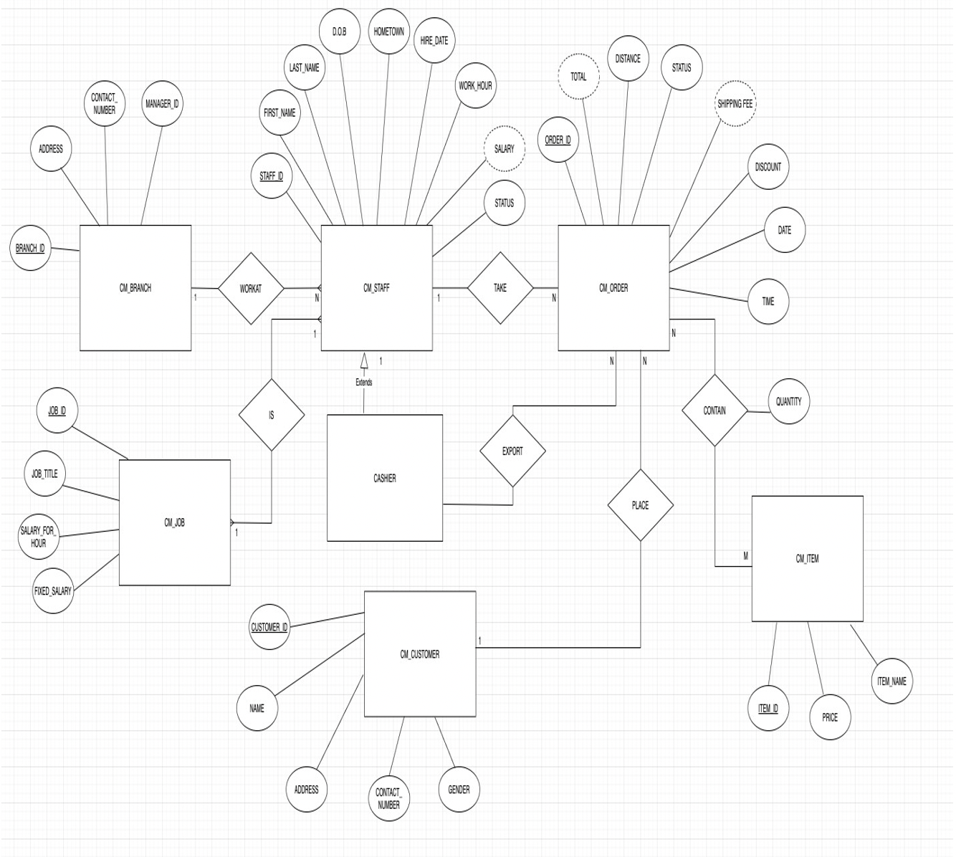
2. Entity relation diagram

Slide 7

13.01.2024
There are 6 entities in this diagram:
CM_BRANCH
CM_STAFF
CM_JOB
CM_MENU
CM_CUSTOMER
CM_CUSTOMER_ITEM

Slide 8
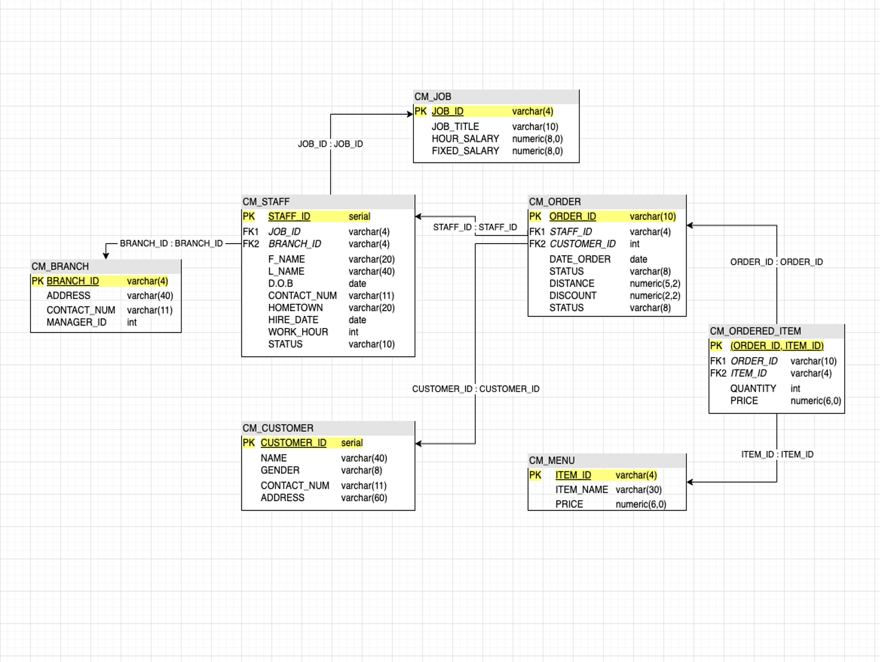
3. Relationship diagram

Slide 9

4. Query
4.1. Create table query
We create tables following to the relation schema
In the creating queries, we defined the type of the data input, the constraint between classes.
4.2 Stored procedure
We create stored function for quick insertion into the database.
One of the design principles is make common case. The stored procedures are usually used; therefore, they will be convenient in using when we need it.

Slide 10
4.3 Role
It offers a well-structured and maintainable method for setting up roles, permissions, and access controls in our database.
Its presence ensures that our database security is strong and flexible, catering to the evolving requirements of both the application and the supporting organization.

Slide 11
4.4 Index
Indexes are used to retrieve data from the database more quickly than otherwise. The users cannot see the indexes, they are just used to speed up searches/queries.
In our database, the search engine will use most the order id, customer id, and order id. All the attributes above are in the tables with huge data and if we want to get to it, we might have to traverse all the data from that table.
Base on principle design, we make common case fast by creating index for those.
ORDER_ID
CUSTOMER_ID
ORDER_ID

Slide 12
4.5 Functions
1. Calculate the shipping fee
2. Get the payment for a bill
3. Find most efficient branch in a chain
4. Get the daily income
5. Get the information of a bill
6. Find loyal customers
7. Find most/least favorited product
8. Calculating the salary
9. Suggest item for a customer
10. Delete and Insert function

Slide 13
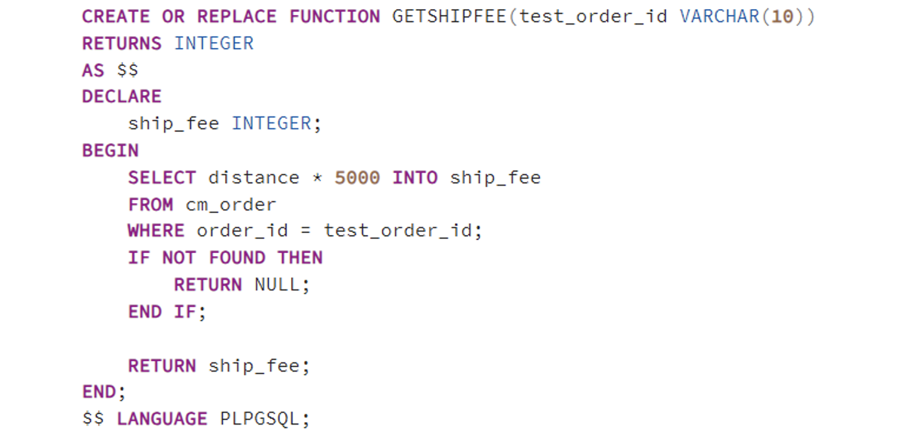
4.5.1. Calculate the shipping fee

Slide 14
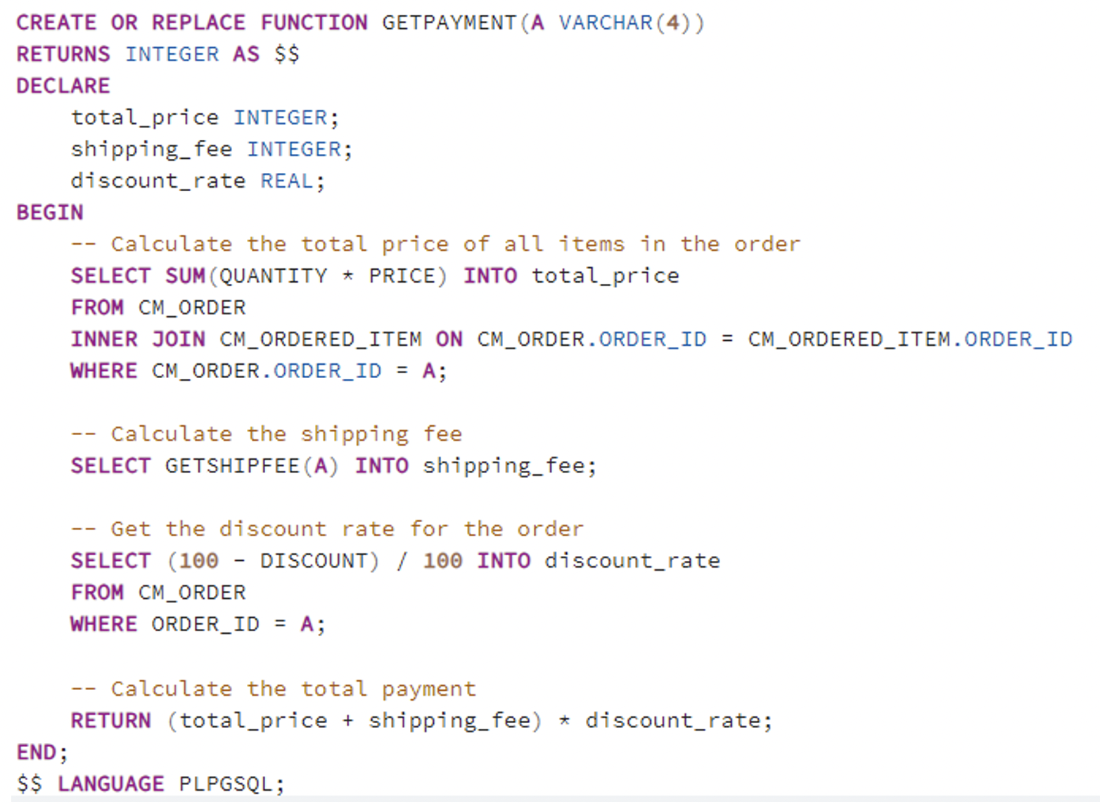
4.5.2. Get the payment for a bill

Slide 15
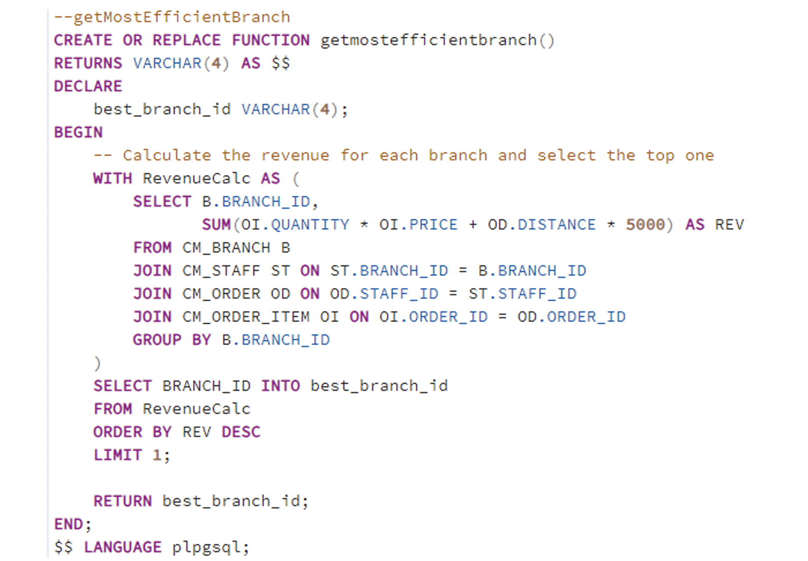
4.5.3. Find most efficient branch in a chain

Slide 16
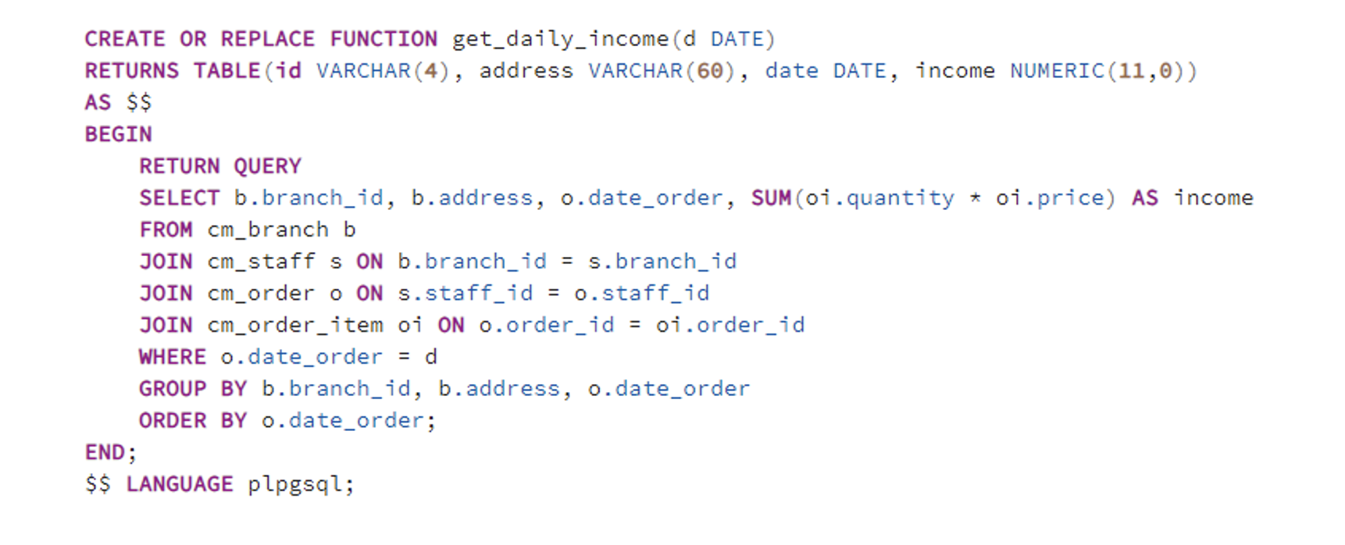
4.5.4. Get the daily income

Slide 17
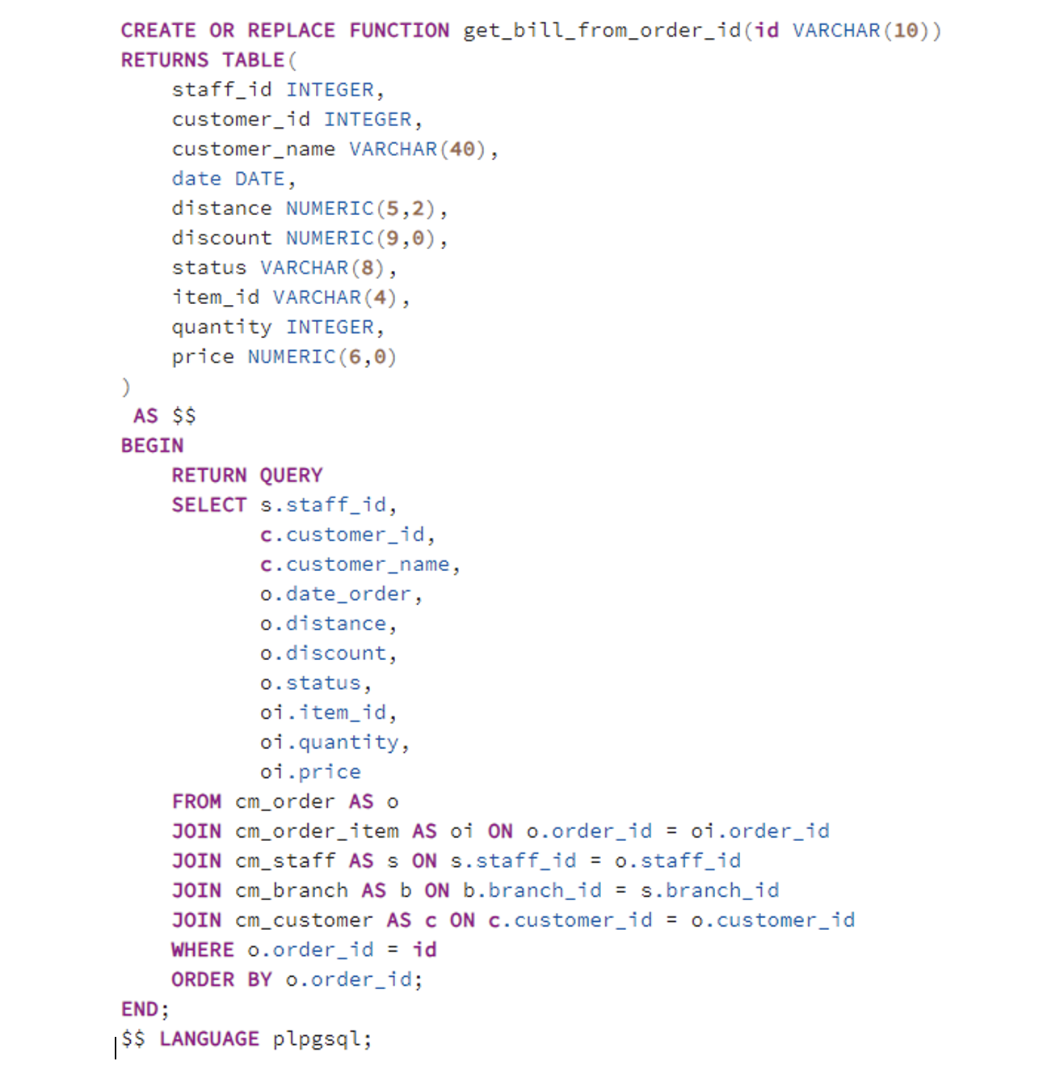
4.5.5. Get the information of a bill

Slide 18
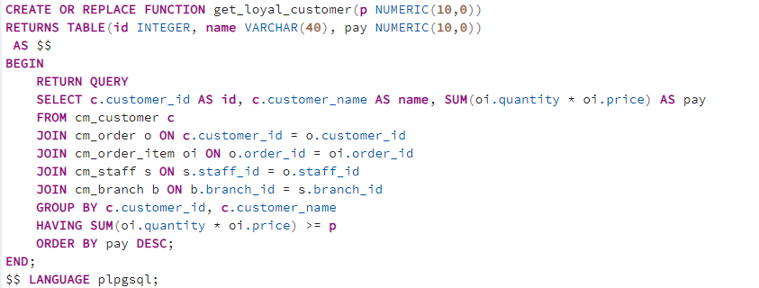
4.5.6. Find loyal customers

Slide 19
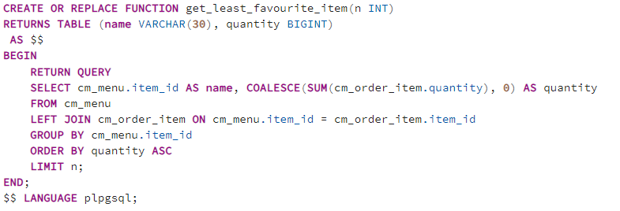
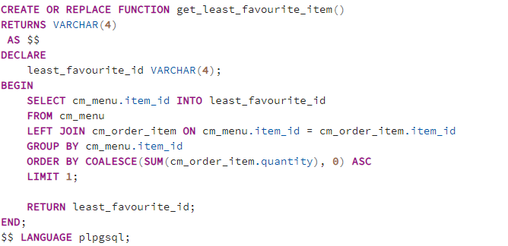
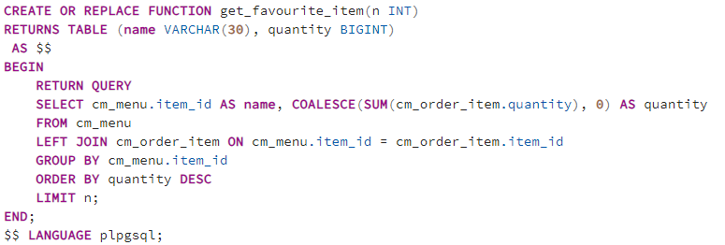
4.5.7. Find most/least favorited product

Slide 20
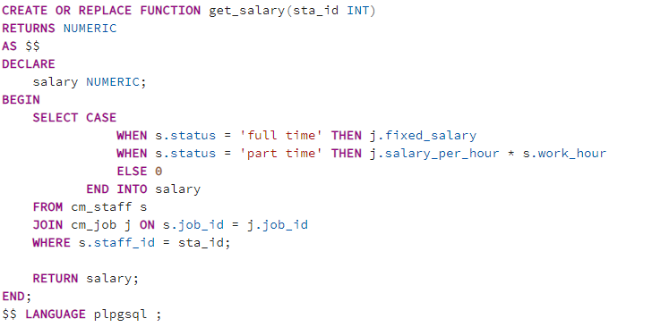
4.5.8. Calculating the salary

Slide 21
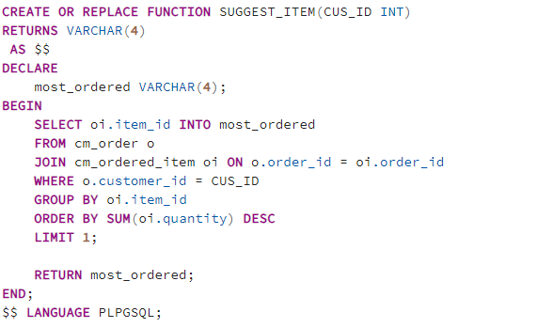
4.5.9. Suggest item for a customer

Slide 22
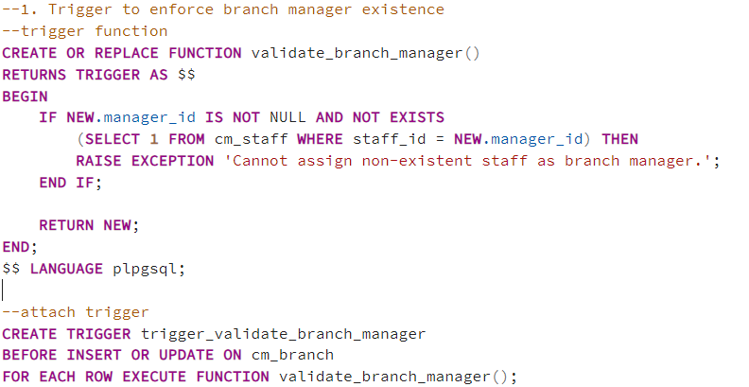
5. Trigger
5.1. Trigger to enforce branch manager existence

Slide 23
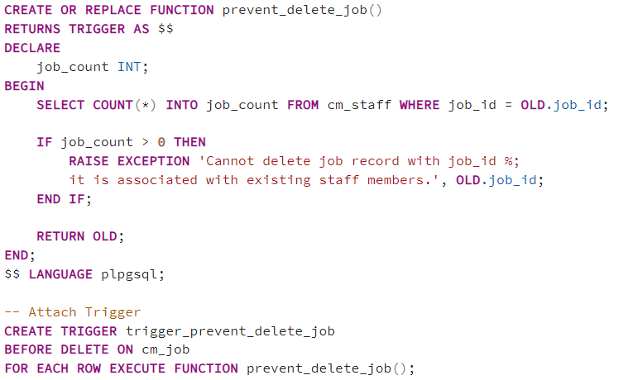
5. Trigger
5.2. Trigger prevent deleting a job

Slide 24
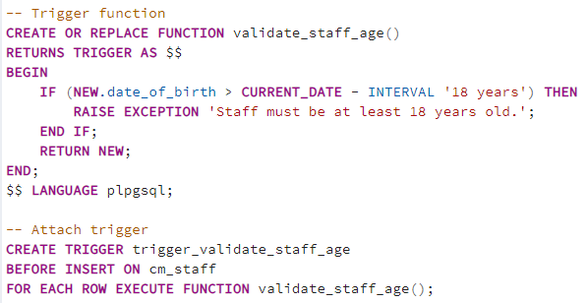
5. Trigger
5.3. Trigger to Validate New Staff Age

Slide 25
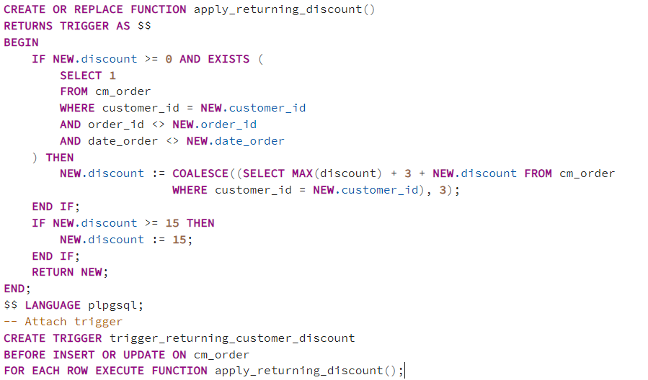
5. Trigger
5.4. Trigger to Automatically Set Discount for Returning Customer

Slide 26
6. View
1. View of All Branches and Their Managers
2. View of Menu Prices
3. View of Job Roles and Salaries
4. View of Staff Details
5. View of Customer Details
6. View of Order Summaries
7. View of Total Sales Per Item
8. View of Daily Sales
9. View of Staff Per Branch
10. View of Items Never Ordered

Slide 27
6. View
11. View of Active Customers
12. View of Staff Full-time and Part-time
13. View of Most Recent Orders
14. View of Average Distance for Online Orders
15. View of Customer Order History

Slide 28
7. Contribution
Contribution
Nguyễn Hoàng Việt 20215255 - Functions, View, Trigger 1, 2, Index, Create Table, Report
Nguyễn Việt Thắng 2021524 - ERD, Insert/Delete Function, Role, Trigger 3, 4
Nguyễn Văn Dương 20215189 - Relational Schema, Stored Procedure, Silde

Slide 29

Thank You

